Slide 1

HotelRevAI
AI-Driven Revenue Analysis For Hotels

Slide 2
Agenda
Project Overview
Data Loading & Cleaning
Data Modelling
DAX Measure Library
Revenue Performance
Customer & Booking Behaviour
Revenue Optimization
Seasonality & Stay Pattern
Key Findings
Conclusion & Next Steps

Slide 3

Project Overview
Problem Statement
Dataset at a Glance
Hotels generate massive amount of raw booking data daily yet struggle to extract strategic insights. Without Proper Visualisation it is difficult to identify peak seasons, understand channel performance or develop targeted customer analysis.
Source
Kaggle – Hotel booking demand Dataset
Hotel Types
City hotel & Resort hotel
Objectives
Analyse revenue performance & growth trends.
Evaluate ADR, cancellation rate, total bookings, and guest counts.
Analyse customer behaviour and booking patterns.
Create 4 interactive Power BI dashboards with dynamic filtering.
Enable data-driven hotel management decisions.
Records
75,000+ booking records
Period
July 2015 – August 2017
Key fields
ADR, Lead time, Customer type, Distribution channel, Guests

Slide 4



Data Loading & Cleaning
Excel Import
Power query editor raw Excel file import
Data Cleaning
Nulls, types and Duplicated removed
Feature Engineering
Revenue, Guests and Total nights
Data Model Ready
Fact + Dimension tables loaded into Power BI
Cleaning Operations
Handled missing or null values.
Verified and corrected data types.
Removed duplicate booking records.
dropped columns not participating in revenue analysis.
Derived Columns
Total Nights
Total Guests
Revenue
Arrival Date

Slide 5
Data Modelling
Tables Created
Model Relationship
Hotel data (Fact table)
Calander (Dimension table)
D3_measures (Measure table)
Calander [date]
One to many
Hotel data [Arrival date]

Slide 6




DAX Measure Library & Business Metrix
Financial performance
Total revenue
Revenue per night
Revenue loss
Customer Behaviour
Total customers
Repeat %
Repeated guests
Occupancy & Demand
Total guest count
Occupancy proxy
Total guest stayed
Booking patterns
Total bookings
Booking new
Booking repeated
16 DAX measures

Slide 7
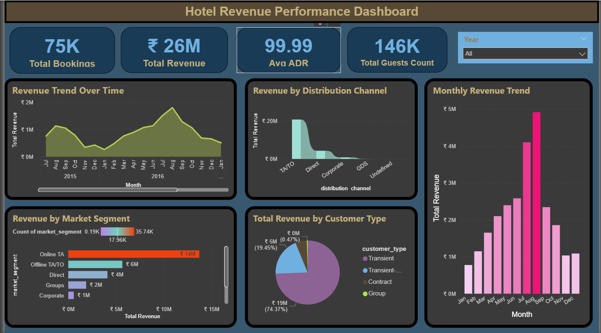
Dashboard 1: Hotel Revenue Performance
Online TA dominates
Online TA has highest revenue
Transient – 74% revenue
Transient customers covers three quarters of all hotel revenue
August peak month
Revenue peak in august in every year

Slide 8
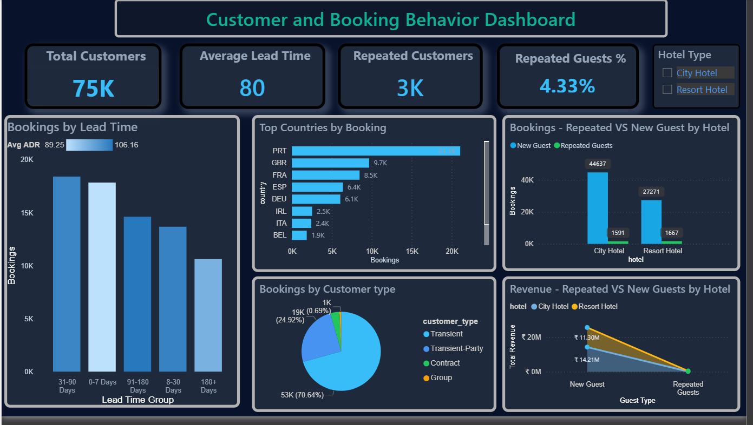
Dashboard 2: Customer and Booking Behaviour
Low loyalty rate
Only 4.33% repeated guests, significantly low repeated guests
Portugal dominates
Portugal leads with highest 20k+ bookings
31-90 day sweet spot
Early bird 31-90 days achieve highest booking and significantly high avg ADR
Transient majority
Around 70% of all booking are from transient customers

Slide 9
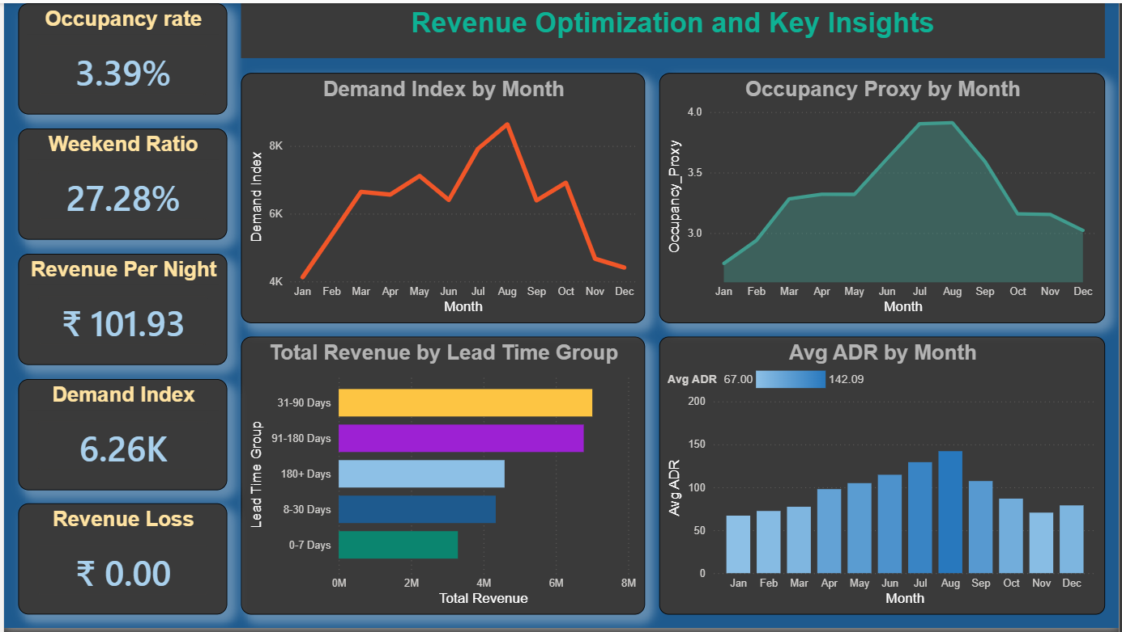
Dashboard 3: Revenue Optimization and Key Insights
Demand index and occupancy highest in august
Advanced booking generates highest revenue
Average ADR highest in august

Slide 10
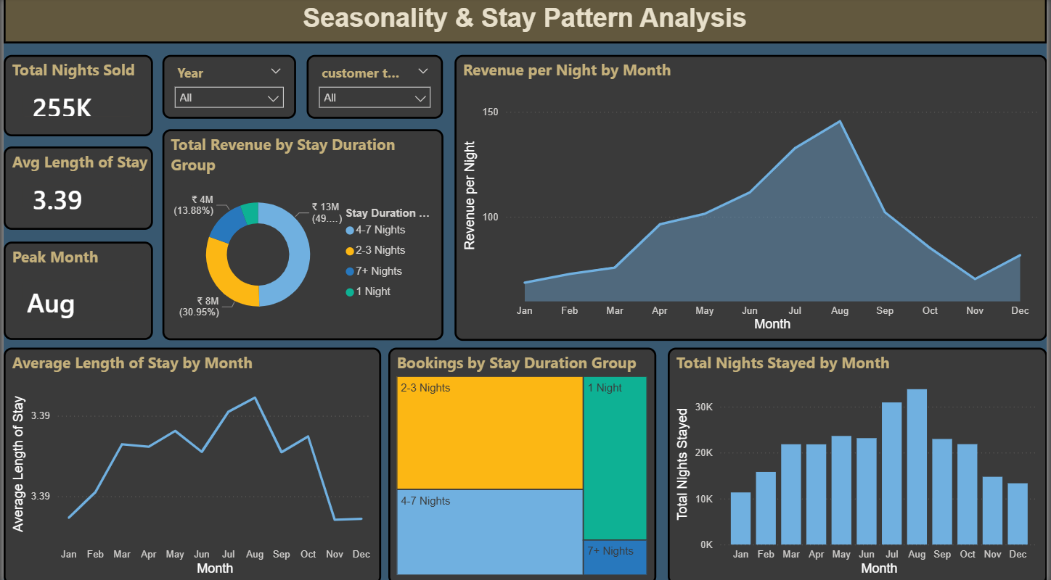
Dashboard 4: Seasonality and Stay Pattern Analysis
Short stays dominates
Stay of 3-4 days dominates overall and 49% of revenue generated by 4-7 night stay
Low season
January and November generates low revenue
Peak august
August peak month across all

Slide 11
Conclusion
The HotelRevAI project demonstrates how Power BI can transform raw hotel booking data into actionable business insights through data loading, modelling, and interactive dashboards. The analysis highlights key revenue drivers such as OTA channels, Transient customers, peak demand in August, and longer stays. These insights support strategic decisions like dynamic pricing, improved cancellation policies, loyalty programs, and growth of direct booking channels to enhance revenue performance.
Future Enhancements
Machine learning models for demand forecasting.
Real-time live booking pipeline.
Customer segmentation modelling using clustering.
Competitor rate benchmarking.
Automated anomaly detection alerts.

Slide 12
Thank You

